Slide 1
DeepShield: A Multi-Head, Explainable Audio Deepfake Detection and Risk-Aware Trust Gateway System
Name of Inventor(s)
Laksh Baweja
Hamsini Goel
Mohith
Dinesh Kumar

Slide 2
Inventor Name |  | Email ID | Mobile Number | College Address
First Name | Second Name
Laksh | Baweja | lb4397@srmist.edu.in | 8700390109 | SRM Institute of Science and Engineering, KTR
Hamsini | Goel | hg7964@srmist.edu.in | 9599752976
Mohith |  | mb5231@srmist.edu.in | 8328293949
Dinesh | Kumar | dk4672@srmist.edu.in | 6369181238

Slide 3
Table of Content
Title | Slide Nos.
Recommendation Summary | Slide 4
Seriousness of Pain Point (or) Problem Statement | Slide 7
Opportunity Review | Slide 5
Independent Claim | Slide 11
Main Patentable Points | Slide 13
Dependent Claim | Slide 12
Prior Art Comparison | Slide 14
Prior Art Search Results | Slide 15
Detailed Explanation of the Invention with Use Results | Slide 16

Slide 4
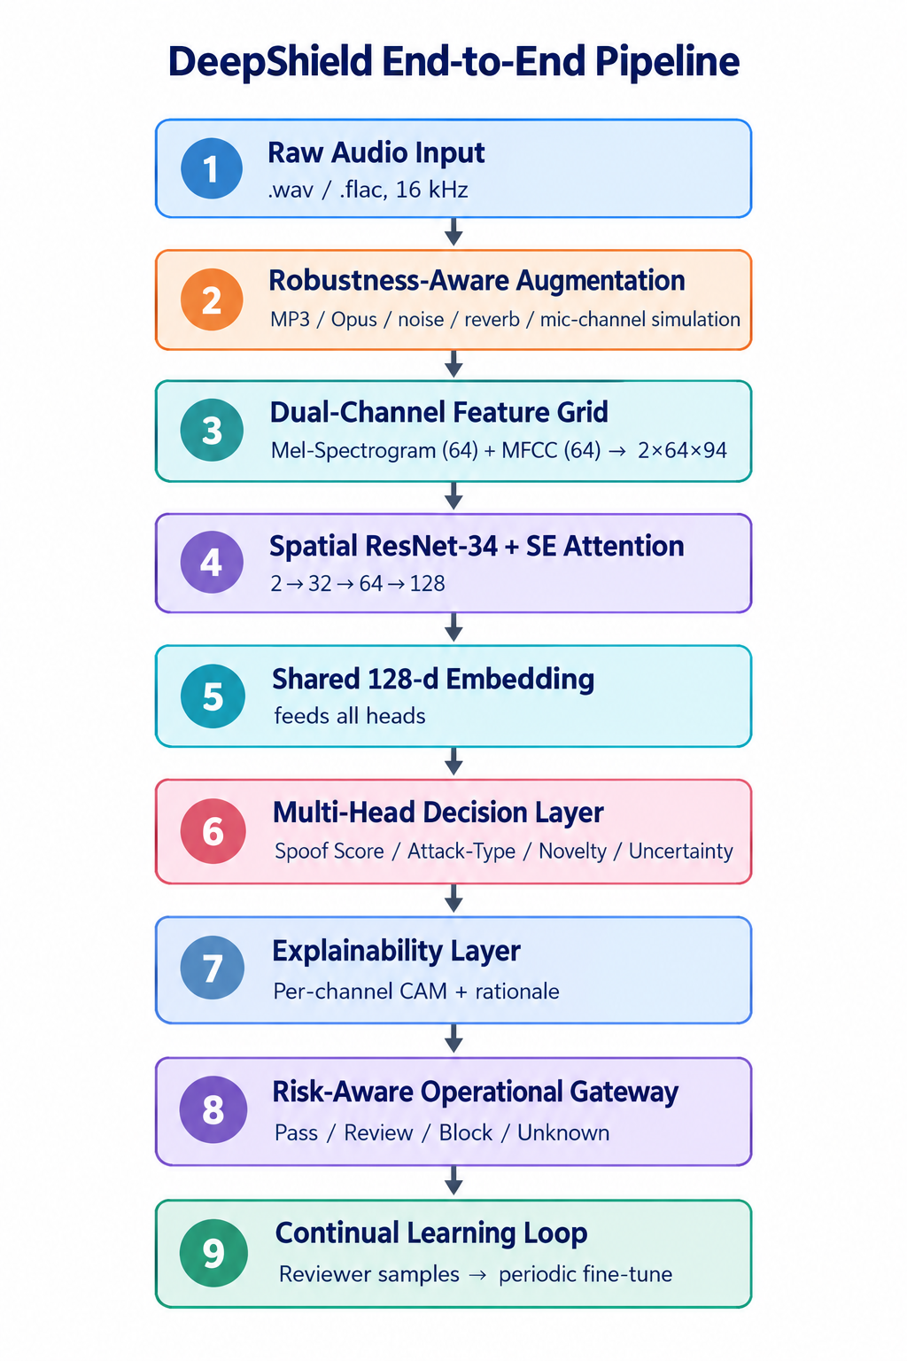
Recommendation Summary
Summary of the Invention | Representative Drawing | Evaluation Opinion
The invention introduces an audio deepfake detection system that goes beyond a binary real/fake call. A dual-channel (Mel-spectrogram + MFCC) feature grid goes through a residual CNN with Squeeze-and-Excitation attention to produce one shared 128-d embedding. Four heads read that embedding in parallel: spoof score attack-type attribution open-set novelty predictive uncertainty A risk-aware gateway uses all four signals together to route each input to Pass, Review, Block, or Unknown Pattern. An explainability layer gives a human-readable reason for every decision, and a continual-learning loop updates the model as new voice generators appear. |  | Prior art Result Opinion: The individual components (Mel/MFCC fusion, SE attention, ResNet) are established. Most published work is binary real/fake classification. What is not covered in prior art: The invention’s claim is that no reviewed work combines detection, attribution, novelty, uncertainty, explainability and continual learning as one jointly-routed system. Class A1 reason: A combination claim: four jointly-routed heads (spoof score, attack-type, open-set novelty, uncertainty) from one shared embedding, plus matched dual-channel explainability — not disclosed in combination by any single prior-art reference found (Slides 14–15); non-obvious over the closest art and industrially applicable to enterprise voice-fraud and compliance workflows.

Slide 5
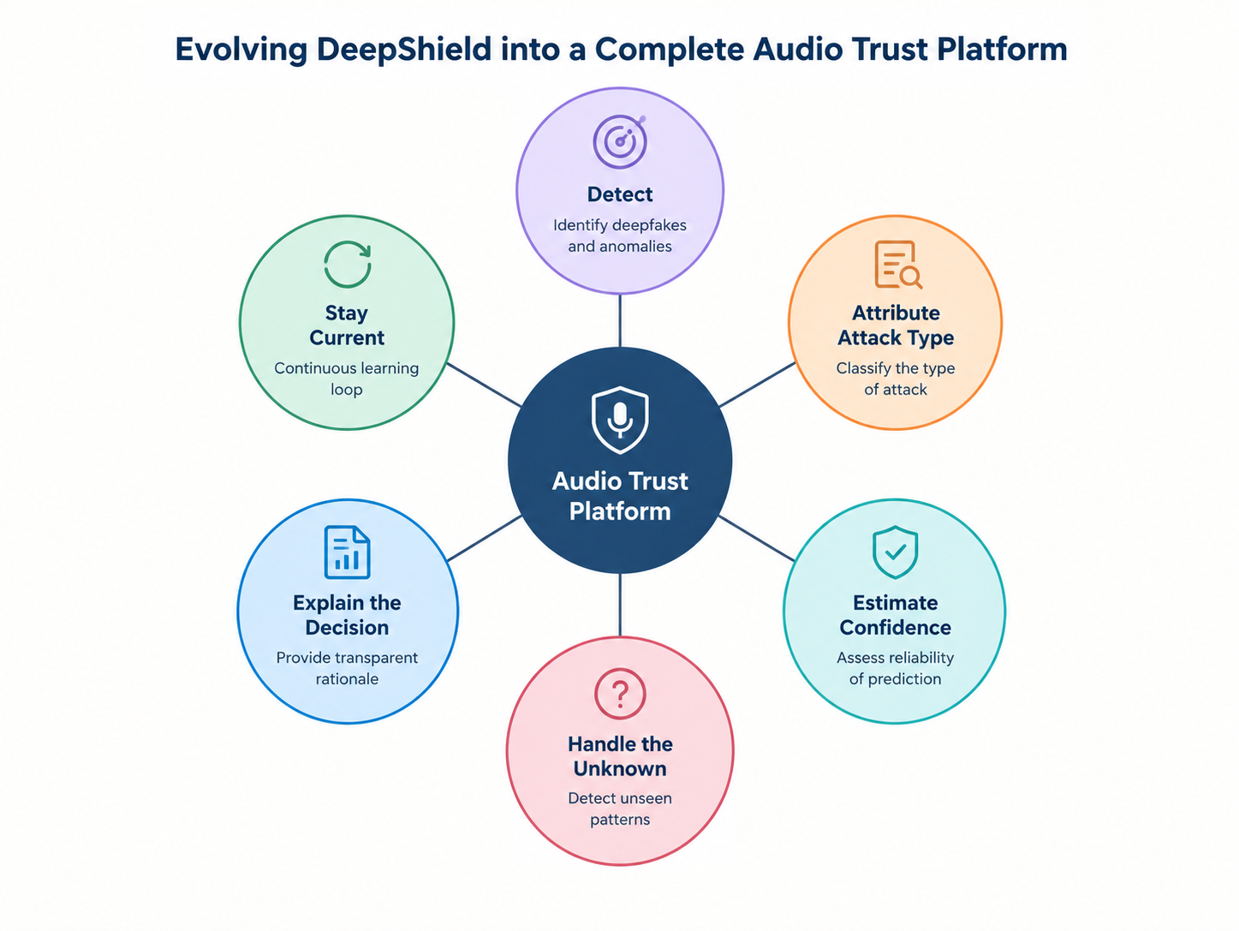

Opportunity Review: Significance
What is the idea?
Instead of asking only "is this audio fake?", the system asks five questions:
Is it fake?
What kind of fake is it?
How confident are we?
Have we seen anything like this before?
Why did we decide this?
Why is it useful?
Voice cloning is improving fast, and a detector trained on today's generators can fail on tomorrow's. Enterprises need decisions they can defend, not just a score.
Significance
Handles unseen or future generators by routing unfamiliar audio to human review instead of silently calling it "real"
Gives reviewers and compliance teams a defensible reason for every Block or Review decision
More realistic, because it is built and tested against MP3, WhatsApp/Opus, noise, reverb and mic variation
Addresses a critical pain point: voice-fraud calls and stored audio evidence

Slide 6
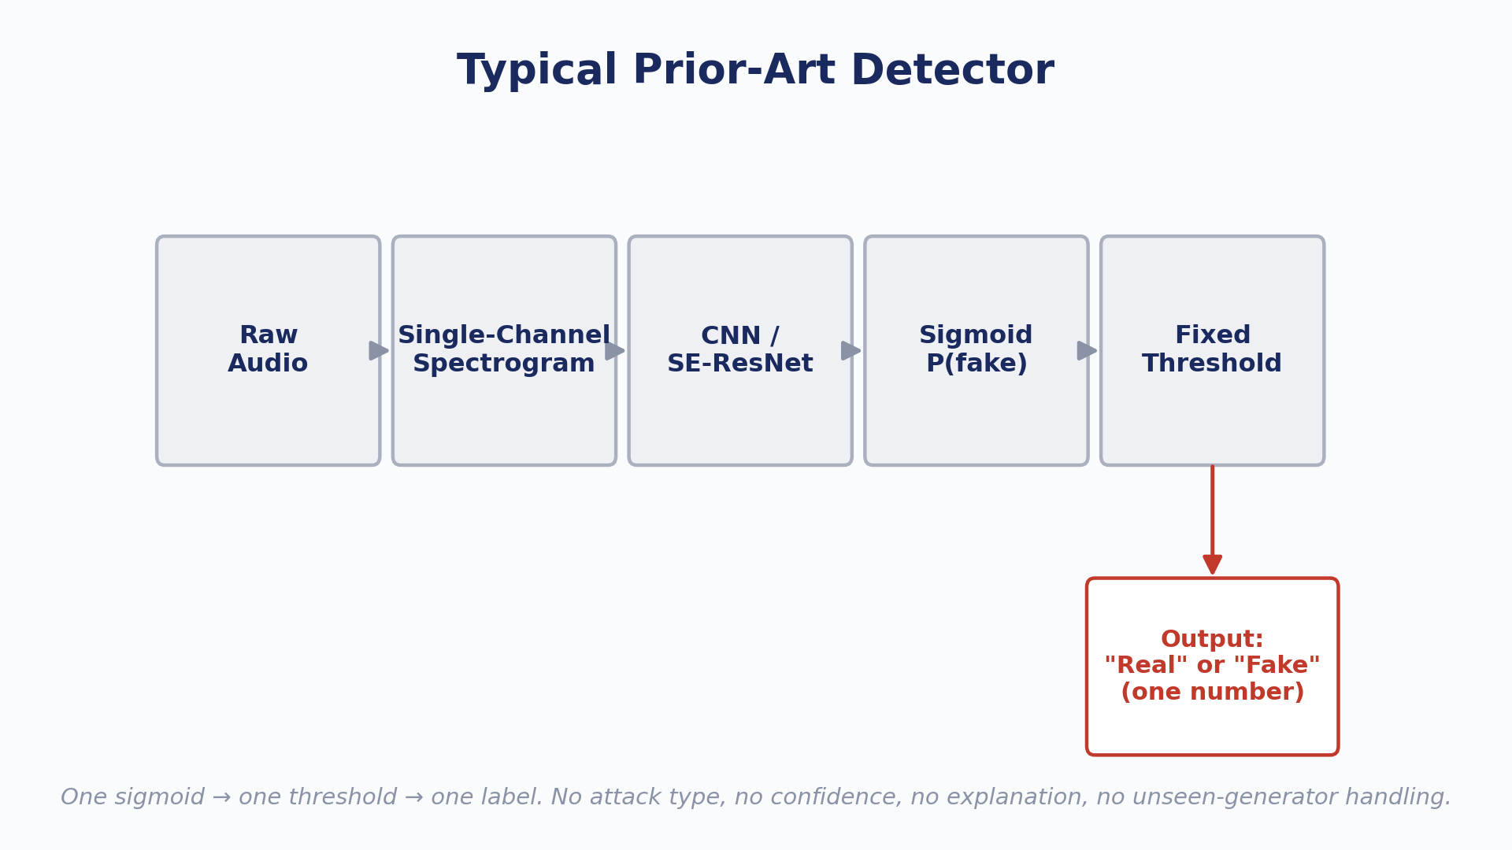
Opportunity Review: Current Solution
  What are the current solutions ?
Single-channel spectrogram CNN detectors
Standard SE-ResNet-style classifiers adapted from the image domain
Static single-threshold binary classifiers (one probability, one cutoff)
Closed-set classifiers that assume a fixed, known list of generators
Generic Grad-CAM/SHAP saliency for explanation

Slide 7
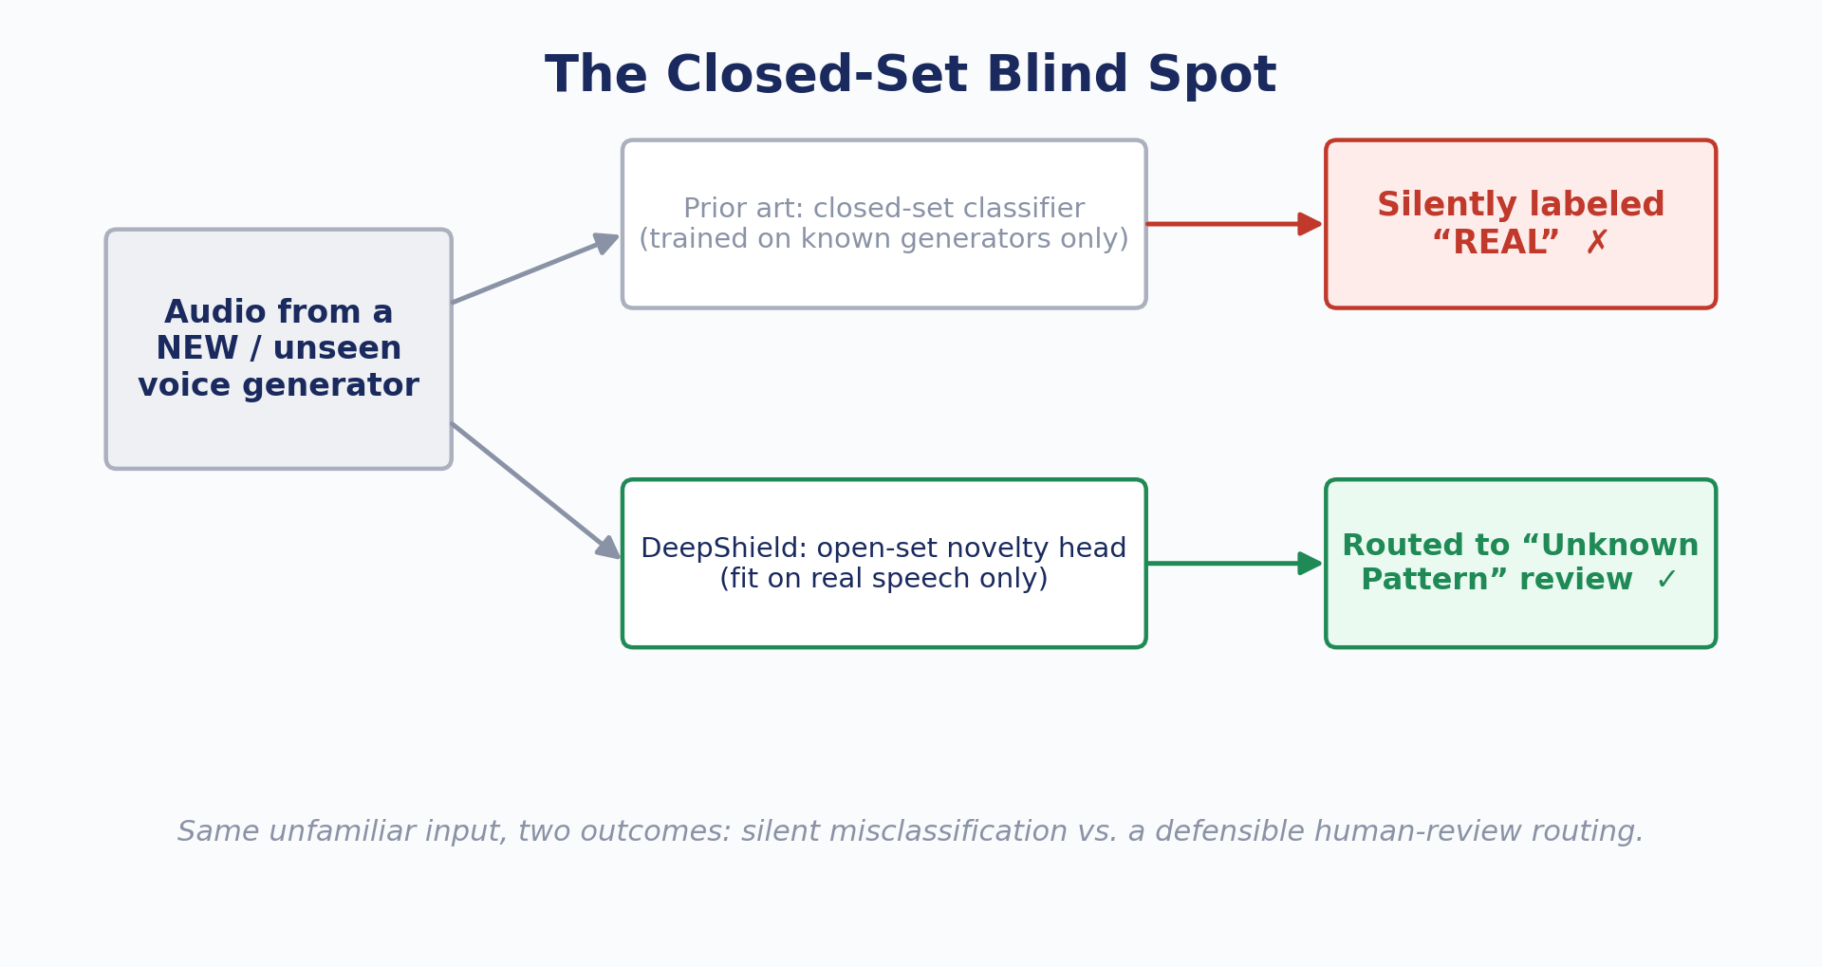
Opportunity Review: Current Solution
  Pain Points of Current Solutions
They output only real/fake, so there is no attack type.
The raw sigmoid is often poorly calibrated, so confidence can't be trusted.
Closed-set training means unseen generators get silently misclassified as real.
Accuracy is reported on a single held-out set. DeepShield's own earlier random-split result of 99.00% dropped to a realistic ~94.5% once same-speaker leakage was accounted for.
Compression, noise, reverb and device variation are rarely tested.
Generic saliency maps aren't specific to why audio is fake.
Training data diversity (language, gender, accent, emotion, speaking rate) is unaudited.
  Key Gaps :
No joint attribution, novelty and uncertainty routing
No defensible explanation
No generalization or robustness guarantees

Slide 8
Opportunity Review: Proposed
Proposed new engine ?:
DeepShield Multi-Head Audio Trust Engine :
Robustness-aware augmentation
Dual-channel 2 × 64 × 94 feature grid
ResNet-34 + SE backbone
Shared 128-d embedding
Four parallel heads
Explainability layer
Risk-aware gateway
Continual-learning loop
What are the advantages:
Answers "what kind of fake" as well as "is it fake"
Flags novel generators via an open-set head fit on real speech only
Calibrated confidence from MC-dropout/ensemble variance
Routing is a joint function of spoof score, novelty and uncertainty
Deterministic rationale for every decision
Stays current through versioned, incremental fine-tuning

Slide 9
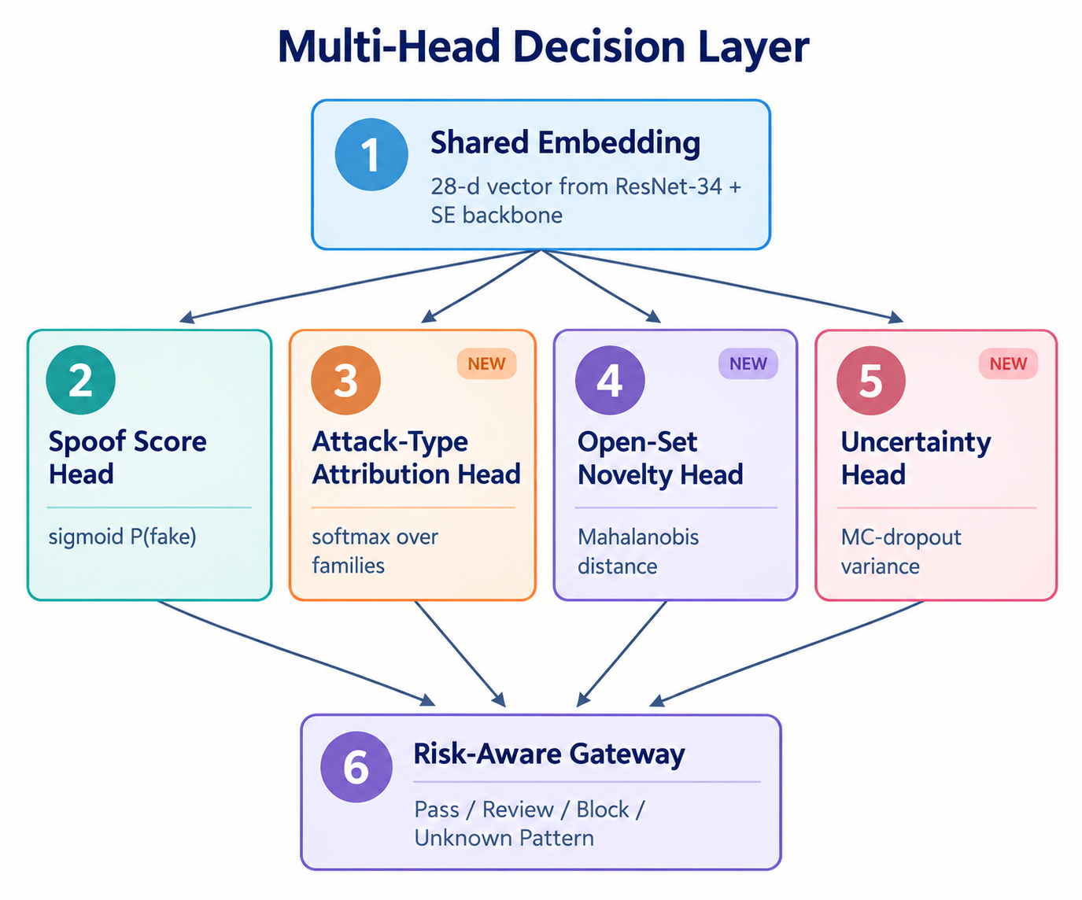
Opportunity Review: Why the new engine works?
Dual-channel fusion: The Mel channel acts as a digital-artifact scanner and the MFCC channel as a vocal-tract plausibility check. Stacking them forces the network to reason across both.
Real-speech-only novelty: Since the novelty head is fit only on authentic speech, anything far from that manifold that doesn't match a known fake cluster is flagged, even from a generator never trained on.
Novelty is checked before the spoof threshold , so unfamiliar inputs can't slip through as "real".
Invariant cues: Features that are physically hard to fake (breath noise, jitter/shimmer, harmonic phase coherence, glottal periodicity) reduce reliance on vocoder artifacts that new generators fix first.
Core Differentiation of Our System:
The gateway decision is a joint function of four signals from one shared backbone.
The explainability output comes from the same dual-channel structure and feeds the same gateway.

Slide 10
Recommendation
1) What is the Core Technology in this Idea?
A dual-channel (Mel + MFCC) ResNet-34/SE backbone producing a shared embedding that feeds four heads (spoof, attack-type, open-set novelty, uncertainty). A risk-aware gateway and per-channel explainability layer sit on top.
2) What complex problem is solved by the idea?
Reliable audio deepfake detection that still works on unseen generators, compressed or noisy real-world audio, and cases where the system must say "I don't know" and explain itself.
3) Why is it a game changing invention?
It turns a one-number classifier into a trust platform: detect, attribute, estimate confidence, explain, handle the unknown, and keep learning. This is what enterprise and compliance deployments need.
4) What is Breakthrough in this Invention?
The jointly-routed gateway, where novelty, uncertainty and spoof score together decide the outcome, combined with an explainability layer built from the dual-channel disagreement between the digital-artifact and biological-plausibility channels.

Slide 11
Independent Claims
In order of relevancy. Please highlight the novel feature(s) in ‘Red’)
Abstract
[Main Independent Claims]
Claim 1 : A method for detecting synthetic speech, comprising:
generating a dual-channel feature grid from an input audio signal, a first channel being a log-power Mel-spectrogram and a second channel an MFCC representation;
processing the grid through a residual convolutional network with channel attention to produce a shared embedding;
computing from the shared embedding, in parallel, a spoof score, an attack-type attribution, an open-set novelty score (distance from a model fit only on authentic-speech embeddings), and an uncertainty estimate (MC-dropout or ensemble variance);
routing the input to one of Pass, Review, Block, or Unknown Pattern as a joint function of the spoof score, novelty score and uncertainty estimate.
Claim 2 : A method as in Claim 1, further comprising generating an explanation from per- channel gradient-based activation maps computed separately for the Mel and MFCC channels, wherein a disagreement map between the two is used with the four head outputs to produce the routing rationale.
The invention is a multi-head audio deepfake detection and trust system that detects synthetic speech, attributes the attack family, flags previously unseen patterns, estimates calibrated confidence, and explains each decision. All of this comes from one shared dual-channel backbone.
Use Cases
Voice-fraud call screening (WhatsApp/VOIP)
Forensic review of stored audio evidence
Call-center authentication
Enterprise compliance workflows with a human review queue

Slide 12
Dependent Claims
In order of relevancy. Please highlight the novel feature(s) in ‘Red’)
Claim 3: The method of Claim 1, wherein the novelty score is a Mahalanobis distance from a Gaussian (or a one-class SVM) fit on authentic-speech embeddings, and the novelty check is applied before the spoof-probability thresholds.
Claim 4: The method of Claim 1, wherein the attribution head classifies among known artifact families (vocoder-checkerboard, TTS-prosody- flatness, splice/edit, channel-mismatch, unknown), trained jointly on the shared embedding.
Claim 5: The method of Claim 1, wherein the uncertainty estimate is produced by MC-dropout or a small ensemble at inference.
Claim 6: The method of Claim 2, wherein the rationale is a deterministic, template-based natural-language summary assembled from the head outputs.
Claim 7: The method of Claim 1, further comprising training with randomized robustness augmentation (MP3/Opus re-encoding, additive noise at controlled SNR, reverberation, mic/channel simulation, 8 kHz down sampling).
Claim 8: The method of Claim 1, further comprising queuing reviewer-confirmed and high-novelty samples for periodic incremental fine-tuning with versioned model releases.

Slide 13
Main Patentable Points
Patentable Point 1:
A method for jointly routing audio decisions as a function of spoof score, open-set novelty, and calibrated uncertainty from a shared embedding.
Patentable Point 2:
A method for open-set detection of unseen voice generators using a one-class boundary fit on authentic speech only, fused directly into the gateway.
Patentable Point 3:
A method for generating per-channel (Mel vs. MFCC) disagreement-based explanations tied to the routing decision.
Patentable Point 4:
A method for attack-family attribution trained jointly with detection on the same embedding.

Slide 14
Prior Arts Comparision
Prior Art Reference | Differences from Prior Art
Single-channel spectrogram CNN detectors (US 12,462,813 B1) | DeepShield uses joint 2 × 64 × 94 Mel + MFCC fusion, forcing cross-channel receptive fields
Static single-threshold binary classifiers (US 12,592,239 B2) | DeepShield routes jointly on score, novelty and uncertainty
Closed-set generator classifiers (Kinnunen et al. 2019, ASVspoof LA challenge) | DeepShield adds a one-class novelty head fit on real speech only
Generic Grad-CAM/SHAP saliency (Selvaraju et al. 2017; Lundberg & Lee 2017) | DeepShield uses a dual-channel disagreement map plus a deterministic rationale

Slide 15
Difference from Closest Prior Art
DeepShield differs in four ways:
Beyond binary output: the shared embedding feeds four parallel heads (spoof score, attack-type attribution, open-set novelty, uncertainty), not one sigmoid.
Open-set handling: a novelty head fit only on real speech embeddings sends unfamiliar inputs to an "Unknown Pattern" review path instead of misclassifying them.
Joint routing: the gateway decides from spoof score, novelty and uncertainty together, with novelty checked before the probability thresholds.
Specific explainability: a Mel-vs-MFCC disagreement map and a deterministic rationale feed the same gateway, rather than a generic saliency map.
Summary of Deficiencies
Prior approaches output a bare real/fake score and fail silently on unseen generators and degraded audio. They give no calibrated confidence and no specific explanation.
Feature | Proposed Patent (The Solution) | Prior Art
Output | Spoof + attack type + novelty + uncertainty from one shared embedding | Binary real/fake probability
Unseen generators | Novelty head routes to "Unknown Pattern" review | Closed-set; silently misclassified as real
Decision routing | Joint function of score, novelty and uncertainty; novelty checked first | Fixed thresholds on the spoof score
Explainability | Per-channel disagreement map + template rationale | Generic Grad-CAM/SHAP, or none

Slide 16
System Architecture & Module Description

Slide 17
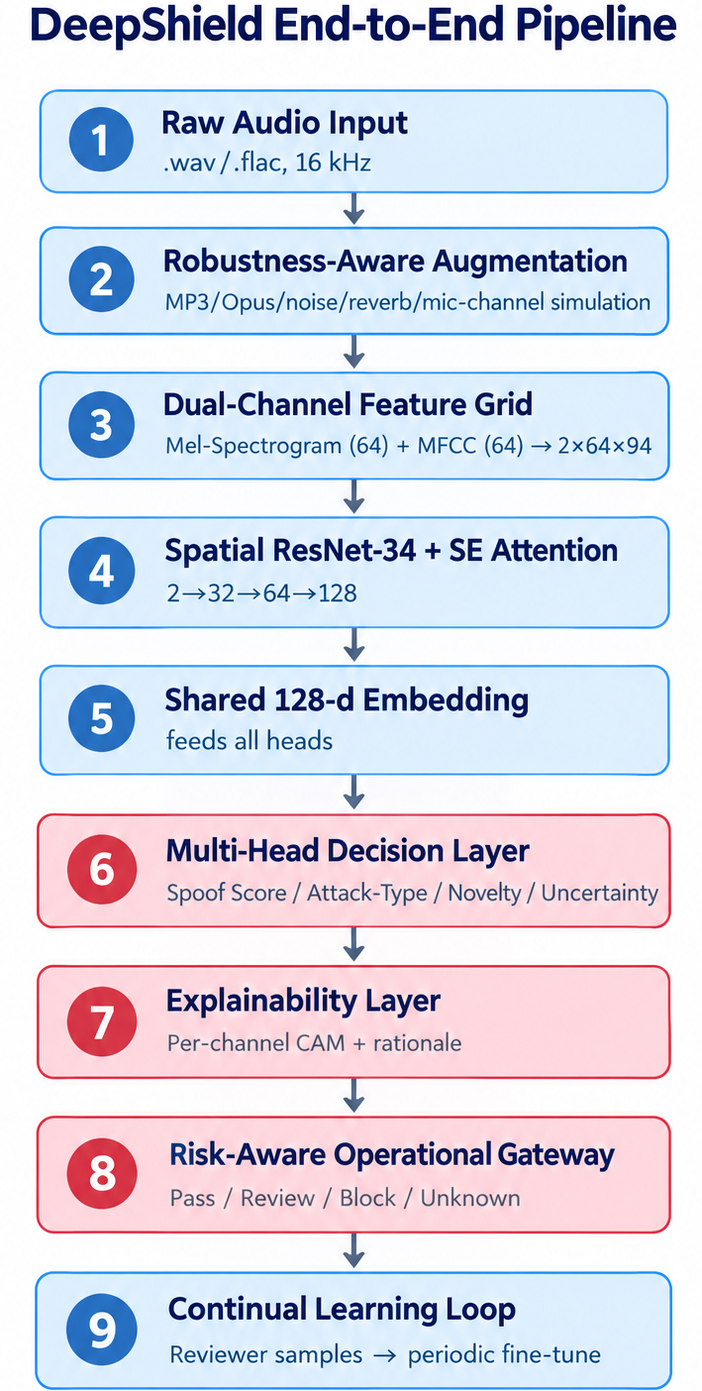
6. Systems and Methods …
Novel Blocks
Raw audio is cleaned, augmented, converted to a Mel + MFCC grid, passed through a ResNet-34/SE backbone, and reduced to one 128-d embedding. Four heads read that embedding, an explainability layer interprets their outputs, and a risk-aware gateway routes the decision. Reviewed samples feed back into periodic fine-tuning.

Slide 18
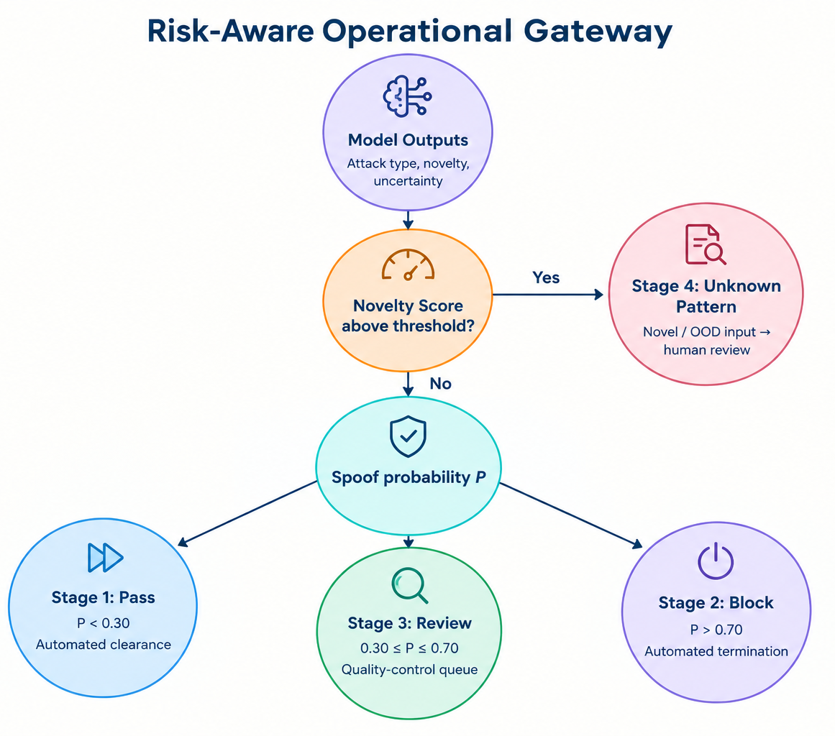
6. Systems and Methods … (contd.)
One shared embedding feeds four parallel heads: Spoof Score, Attack-Type, Open-Set Novelty, Uncertainty. All four outputs go to the gateway together.
The novelty score is checked first. If it is above threshold, the input goes to "Unknown Pattern" human review. Otherwise the spoof probability decides: Pass (P < 0.30), Review (0.30 ≤ P ≤ 0.70), or Block (P > 0.70).

Slide 19
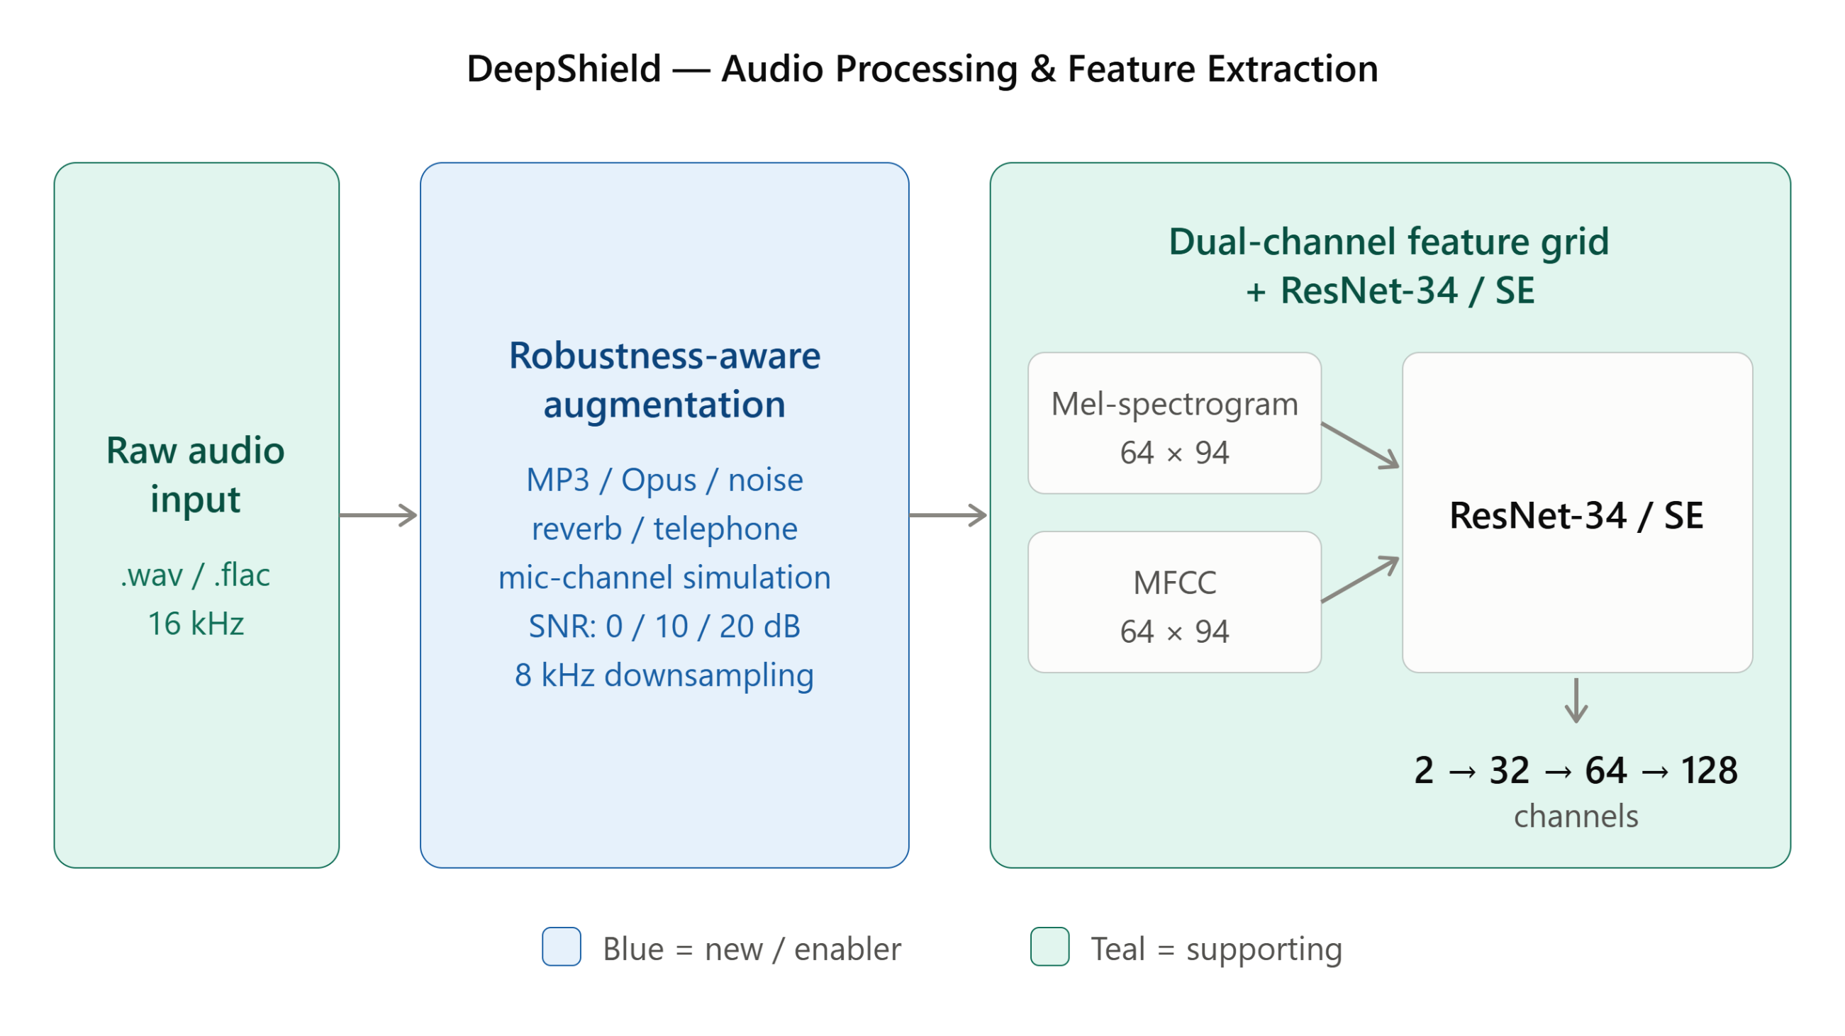
6. Each Module Description & Novelty Block Explanation
Stages 1–3 (supporting front end): audio ingestion, the robustness-aware augmentation added directly in response to mentor review (MP3/Opus re-encoding, additive noise, reverberation, telephone-band downsampling), and the dual-channel Mel-spectrogram + MFCC fusion feeding the ResNet-34/SE backbone. These techniques are individually established (Slide 14); they are the foundation the four novel heads on the next slide operate on.

Slide 20
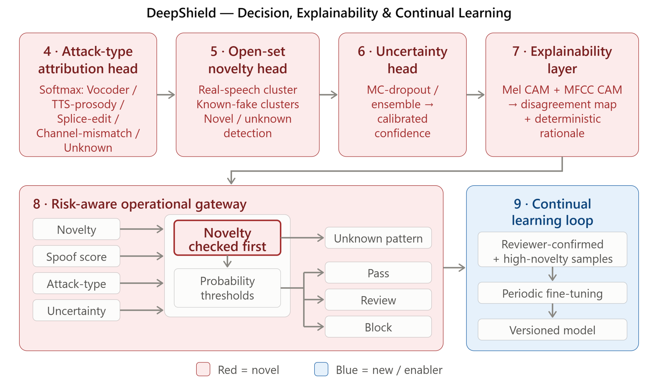
6. Each Module Description & Novelty Block Explanation (contd.)
Stages 4–9 (primary novelty, highlighted above): four parallel heads read one shared embedding — attack-type attribution, open-set novelty (Mahalanobis distance fit on real speech only), and MC-dropout uncertainty, next to the retained spoof-score head. A per-channel disagreement explainability layer and a risk-aware gateway (novelty checked before the probability thresholds) route every decision, and reviewer-confirmed samples feed the continual-learning loop. This jointly-routed combination is the claimed invention (Slides 11–13).

Slide 21
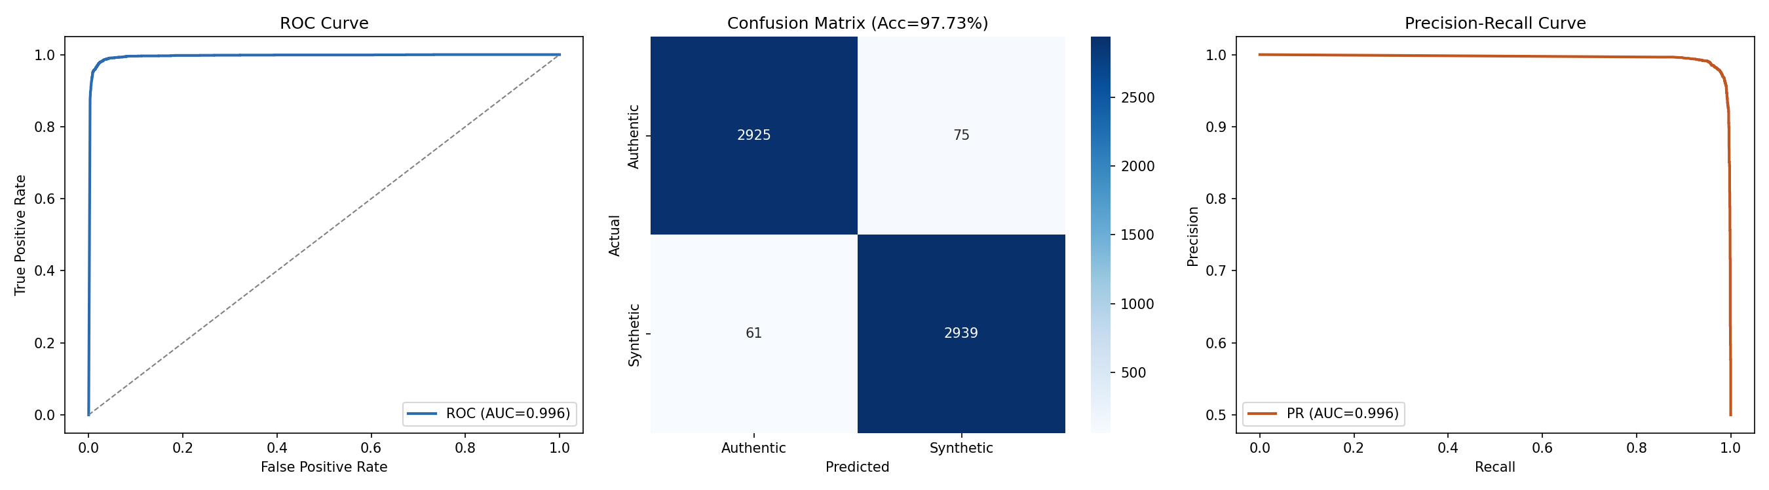
Sample Results
Live Inference Examples — Production API (DeepShield V5, deployed)
Example A — authentic_sample.wav/.mp3 (genuine human speech)
Verdict: AUTHENTIC — P(fake) = 0.00, confidence 1.00
Attack-type head: “real” (97.2% probability)
Novelty score: 11.96 (below 14.74 threshold)
Gateway: Stage 1 – Pass (Automated Clearance)
Rationale: “Cleared as authentic human speech (P=0.00, uncertainty=0.00).”
Re-verified on the MP3-recompressed copy of the same clip — identical verdict.
Example B — synthetic_sample.wav/.mp3 (vocoder deepfake)
Verdict: SYNTHETIC — P(fake) = 0.9998, confidence 1.00
Novelty score: 16.54 (above 14.74 threshold → flagged as novel)
Gateway: Stage 4 – Unknown Pattern → Human Review (not an automatic Block)
Rationale: “Unknown pattern (novelty=16.54 > threshold 14.74): does not match the real-speech manifold or any known attack family. Routed to human review as an out-of-distribution sample.”
Re-verified on the MP3-recompressed copy of the same clip — identical verdict.
Held-out validation (N ≈ 6,000 clips): ROC-AUC 0.996 · Accuracy 97.73% · PR-AUC 0.996. Robustness suite (300 clips/condition): 87–99% accuracy retained under MP3 32–128 kbps, additive noise 0–20 dB SNR, reverberation, and 8 kHz telephone-band audio.

Slide 22
THANK YOU

